Slide 1
DENVar: A global Dynamic Estimate of NDVI Variance
Stefano Mezzini, Gavin L. Simpson, Michael J. Noonan
2025-04-28
Lab update

Slide 2
Origin of remote sensing
First satellite: Sputnik 1, launched in 1957 by Soviet Union
“Passive” data collection: no need for fieldwork
Can monitor landscapes at various spatiotemporal scales
Collect light data (near infra-red, red, green, blue, LIDAR, etc.)
Can create other measures:
Normalized Difference Vegetation Index (NIR – Red) / (NIR + Red)
Enhanced Vegetation Index
Earth’s surface temperature
Human Footprint Index

Slide 3
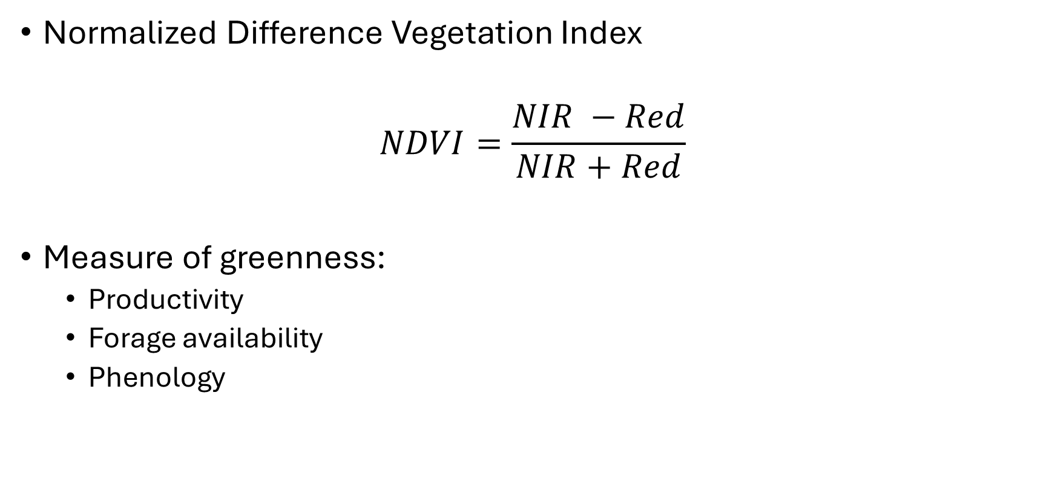
NDVI
Normalized Difference Vegetation Index
$$NDVI=\frac{NIR −Red}{NIR+Red}$$
Measure of greenness:
Productivity
Forage availability
Phenology

Slide 4
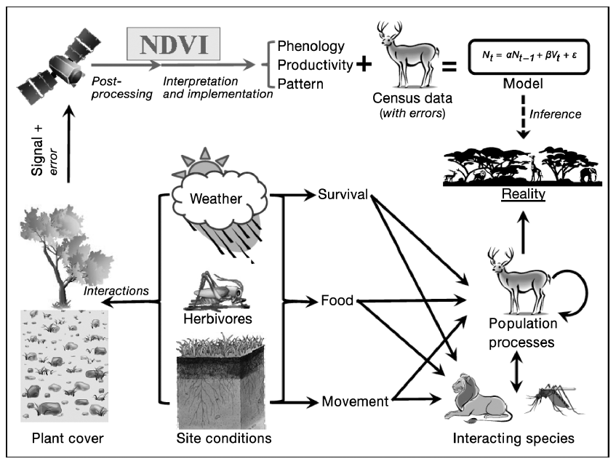
There have been many successes with NDVI
Fig. 1 of Pettorelli et al. (2011) doi.org/10.3354/cr00936

Slide 5
NDVI is a proxy of what we are interested
Fig. 1 of Pettorelli et al. (2011) doi.org/10.3354/cr00936; red box added manually

Slide 6
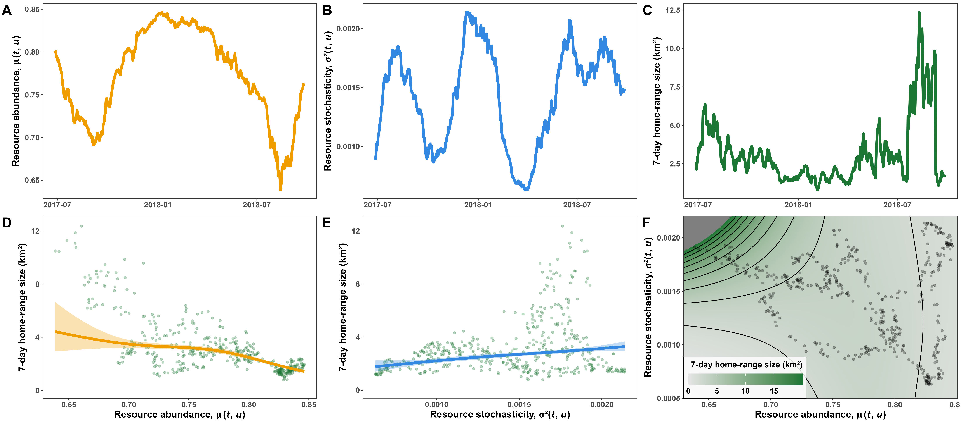

Mean NDVI is a useful proxy
Fig. 5 of Mezzini et al. (2025) https://doi.org/10.1186/s40462-025-00546-5 (edited)

Slide 7
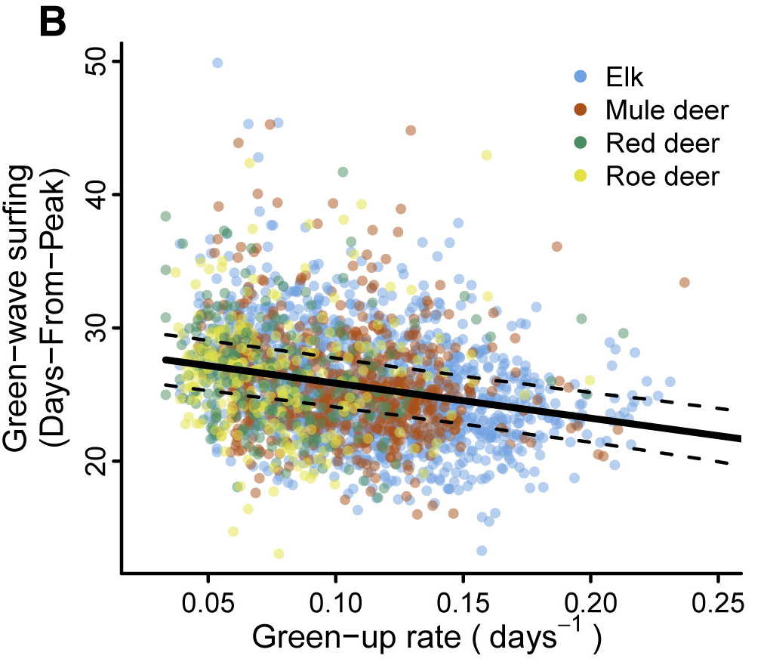
Slope of mean NDVI is a useful proxy
Fig. 2 from Aikens et al (2020) doi.org/10.1016/j.cub.2020.06.032 (cropped)

Slide 8
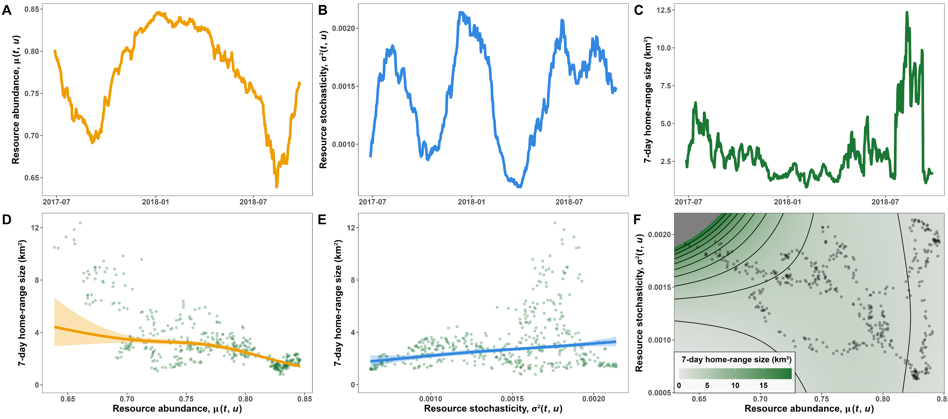
Variance of NDVI is a useful proxy
Fig. from repo of Mezzini et al. (2025) https://doi.org/10.1186/s40462-025-00546-5

Slide 9
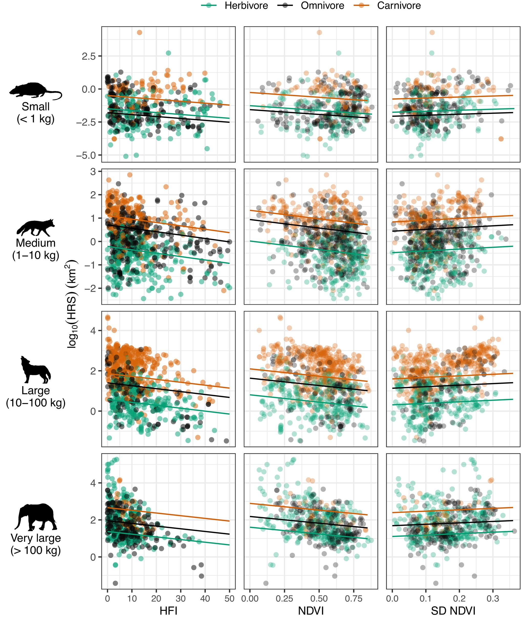
Var(NDVI) is a useful proxy for many species
Fig. 2 from Broekman et al. (2024)
doi.org/10.1111/1365-2656.14073

Slide 10
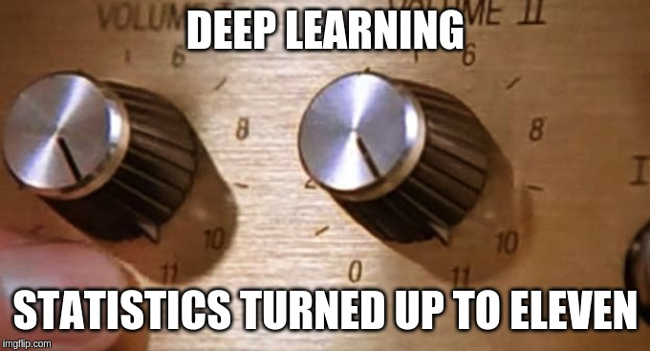
Why not just use deep learning?
Results can be highly accurate but are rarely interpretable
We need communicable models and predictions
We need sensible stats models
From Simpson, Hinz, and Mezzini (2019)

Slide 11
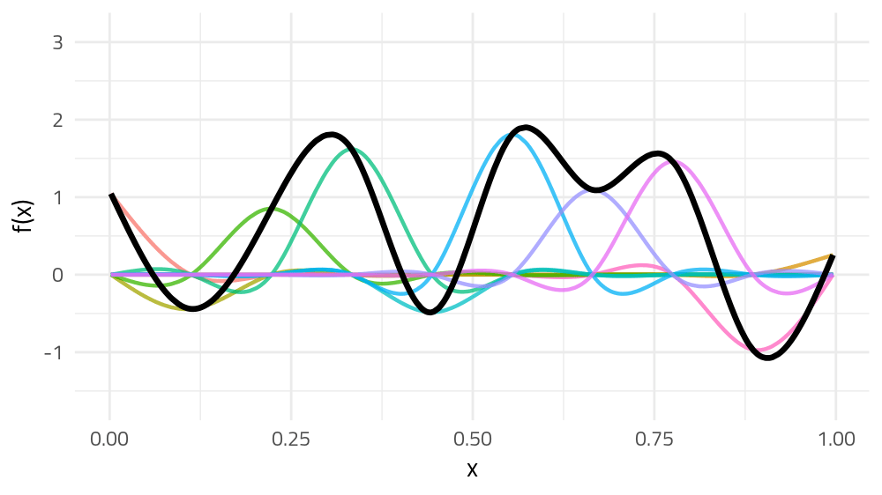
GAMs: flexible yet interpretable models

Slide 12
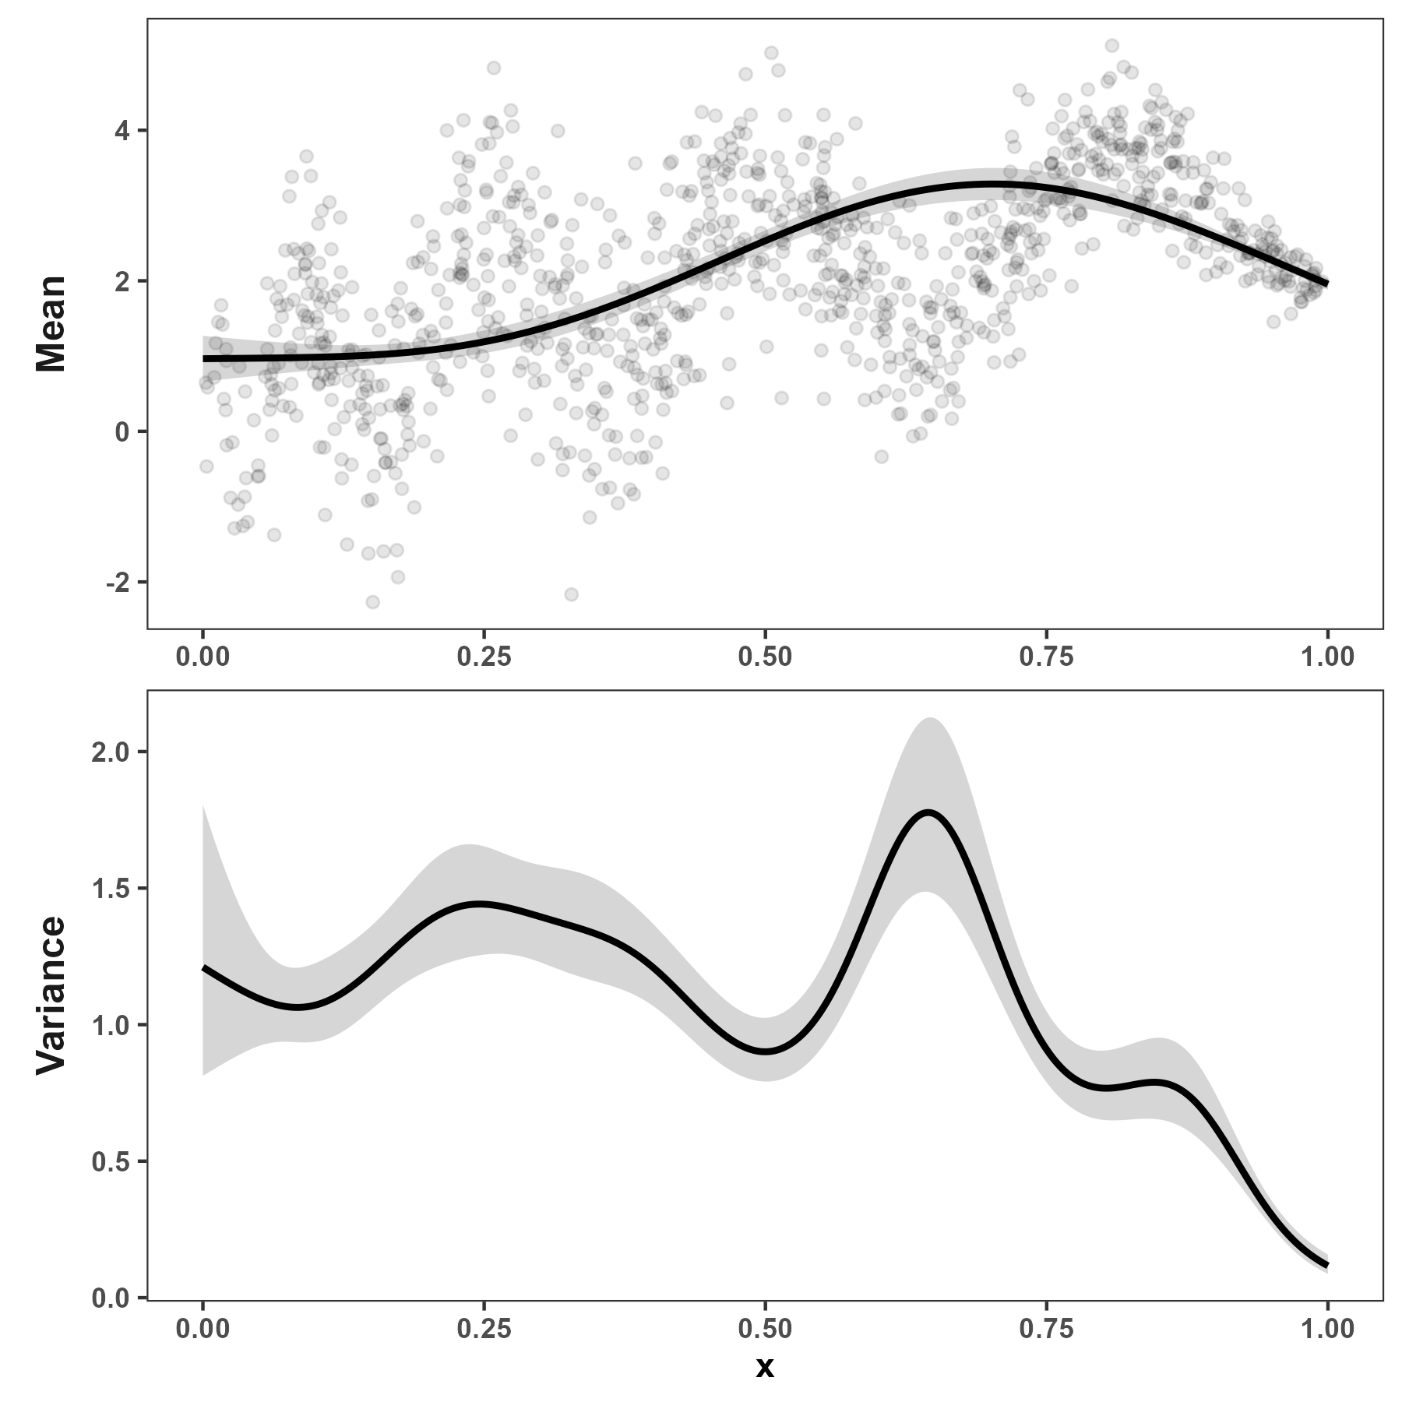
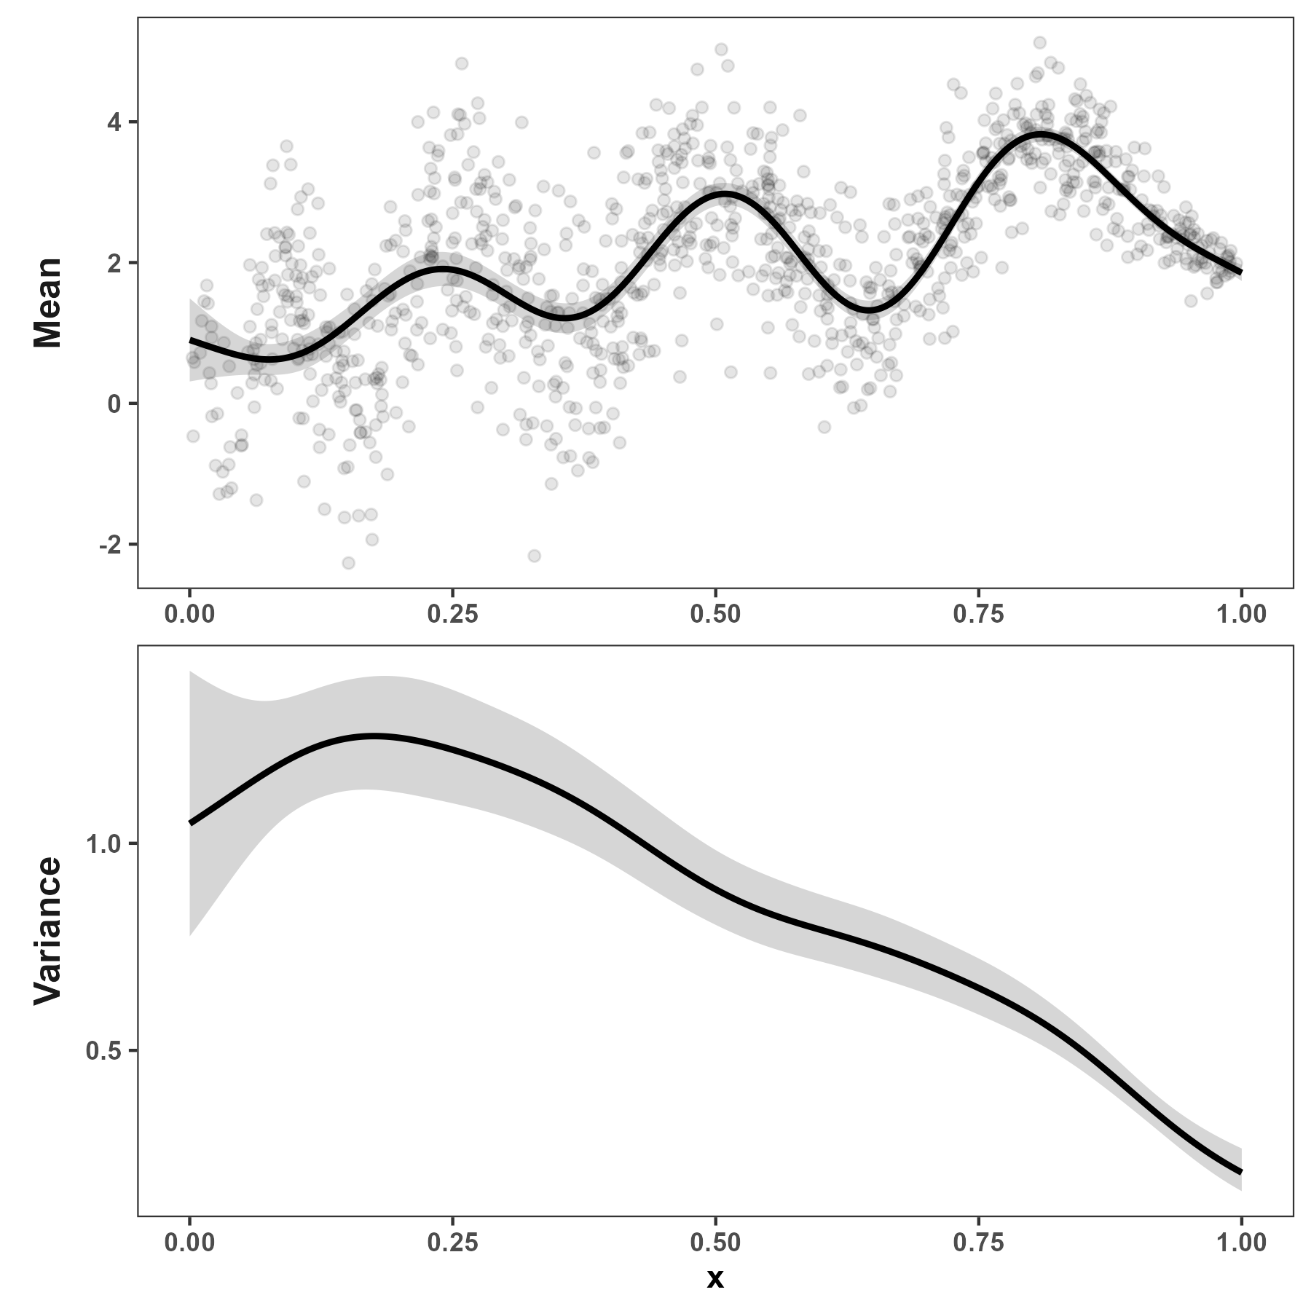
Variance estimate depends on mean estimate
Smooth mean gives large, wiggly variance
Wiggly mean gives small, smooth variance

Slide 13
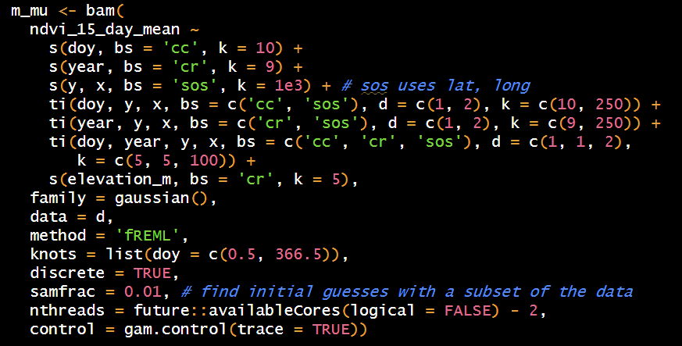
Estimating mean NDVI

Slide 14
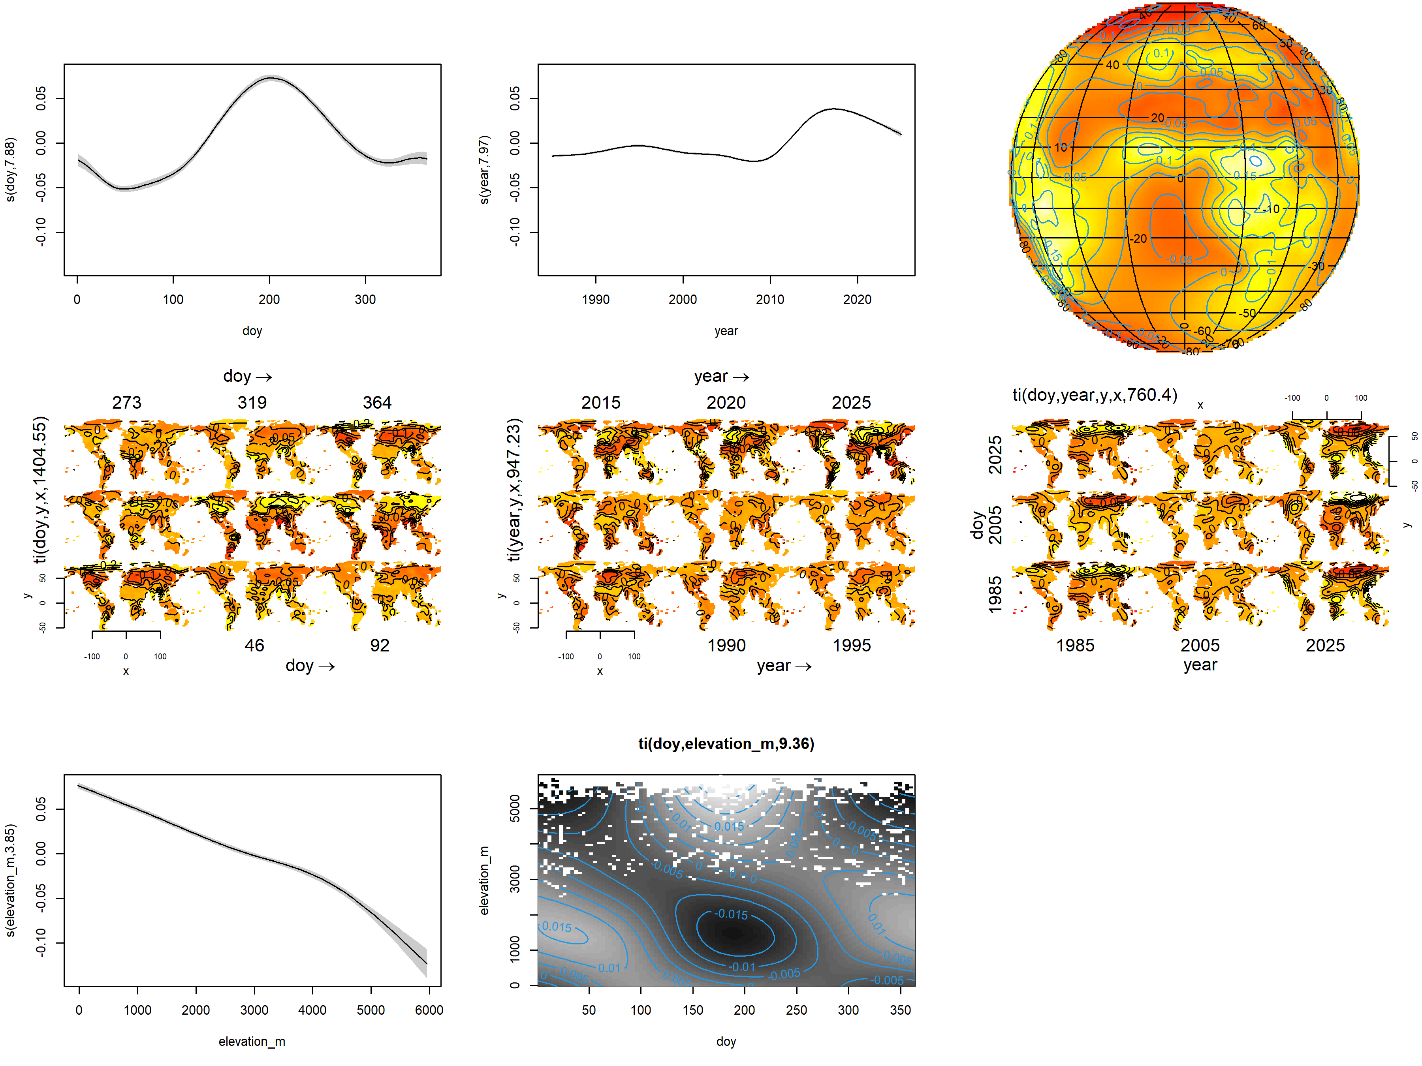
Estimating mean NDVI

Slide 15
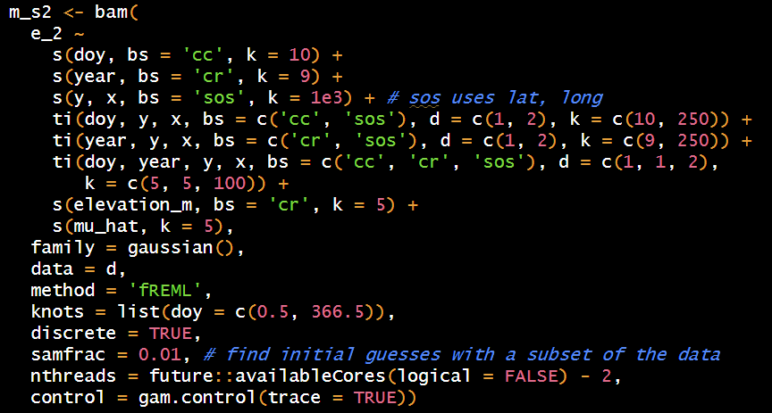
Estimating variance in NDVI

Slide 16
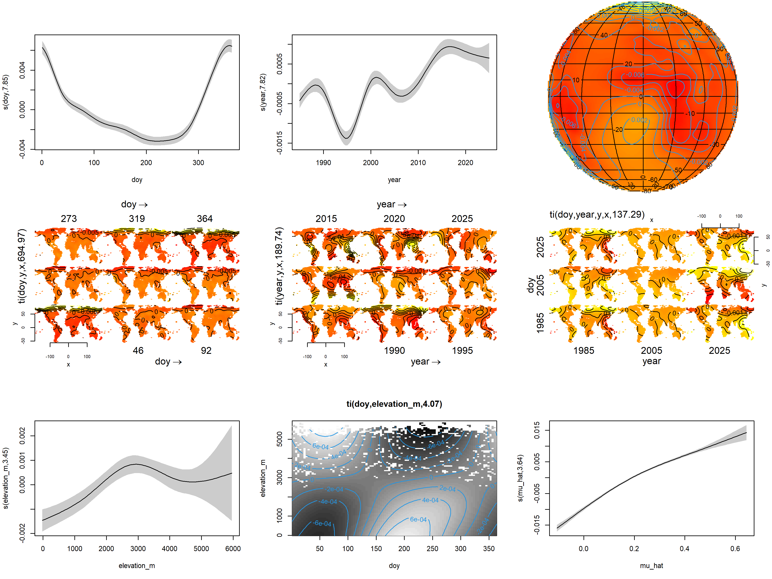
Estimating variance in NDVI

Slide 17
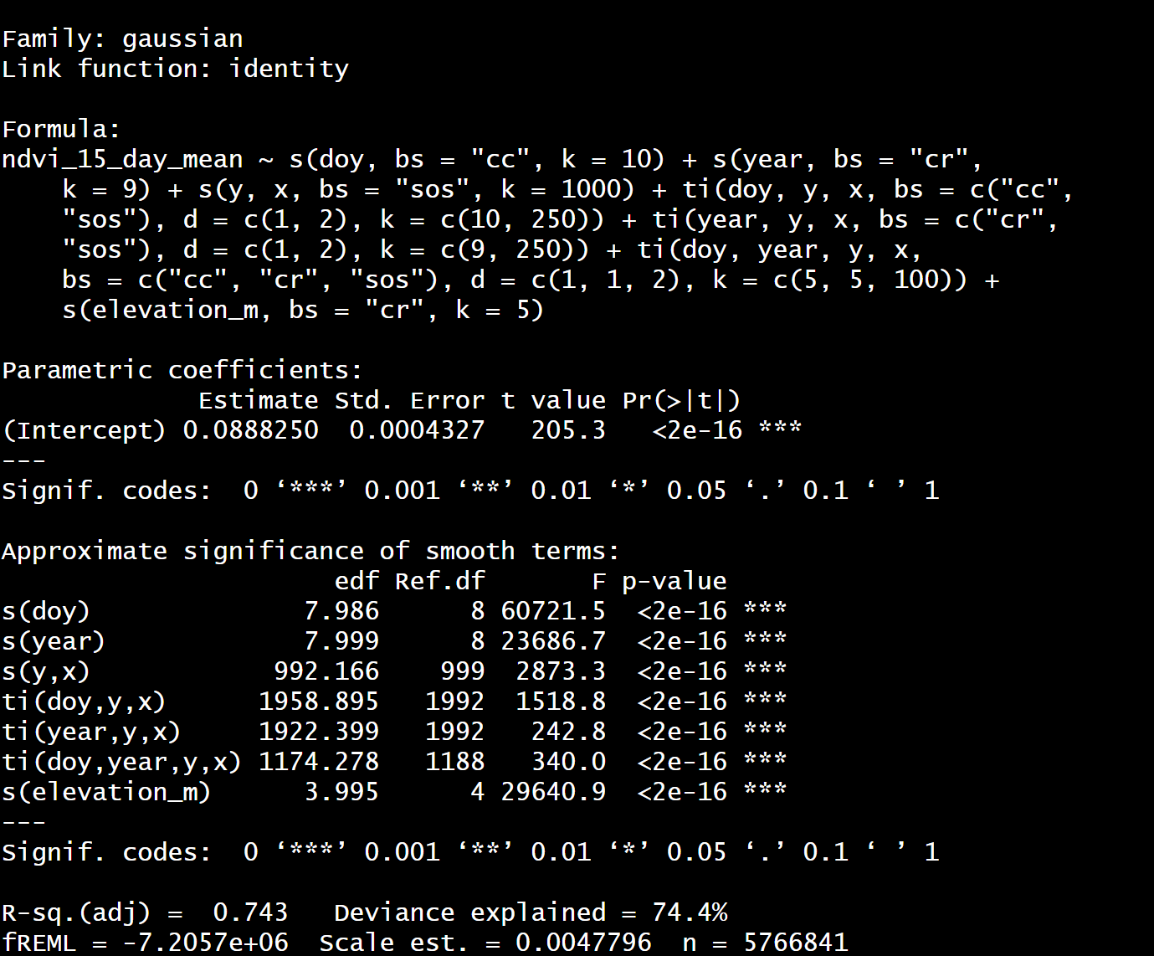
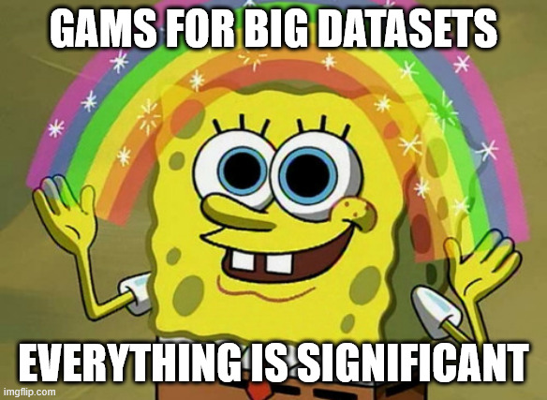
Model statistics for nerds
Deviance explained: Mean : 74.4%; Variance: 14.%

Slide 18
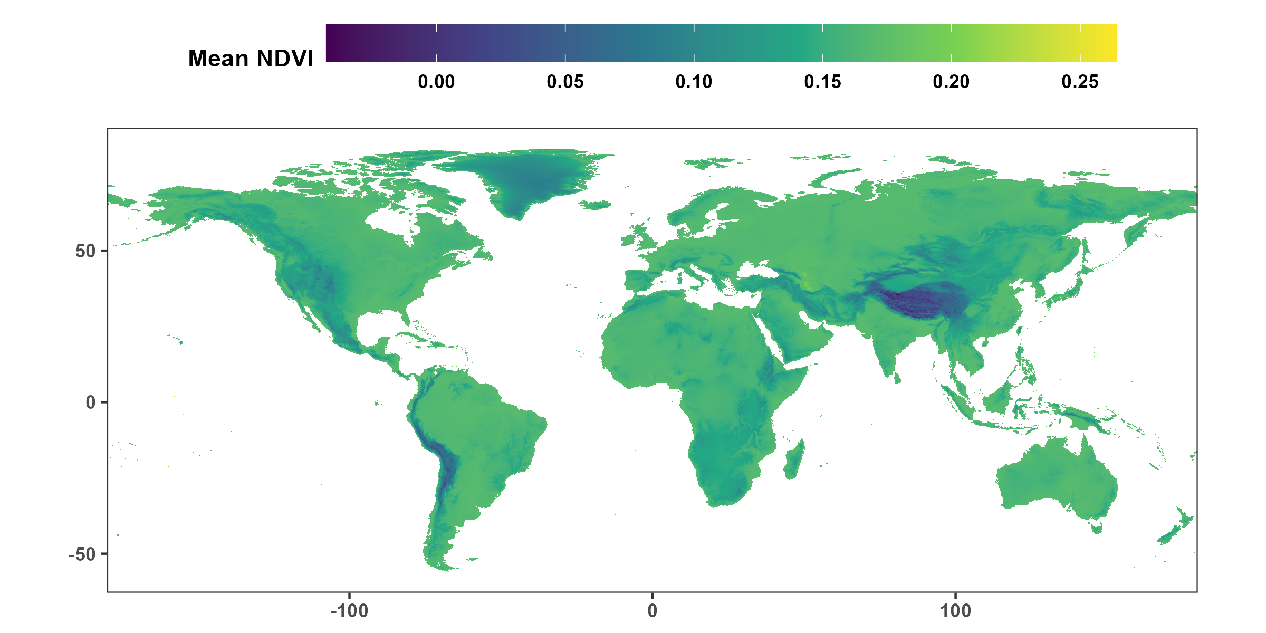
Model predictions: Mean NDVI

Slide 19
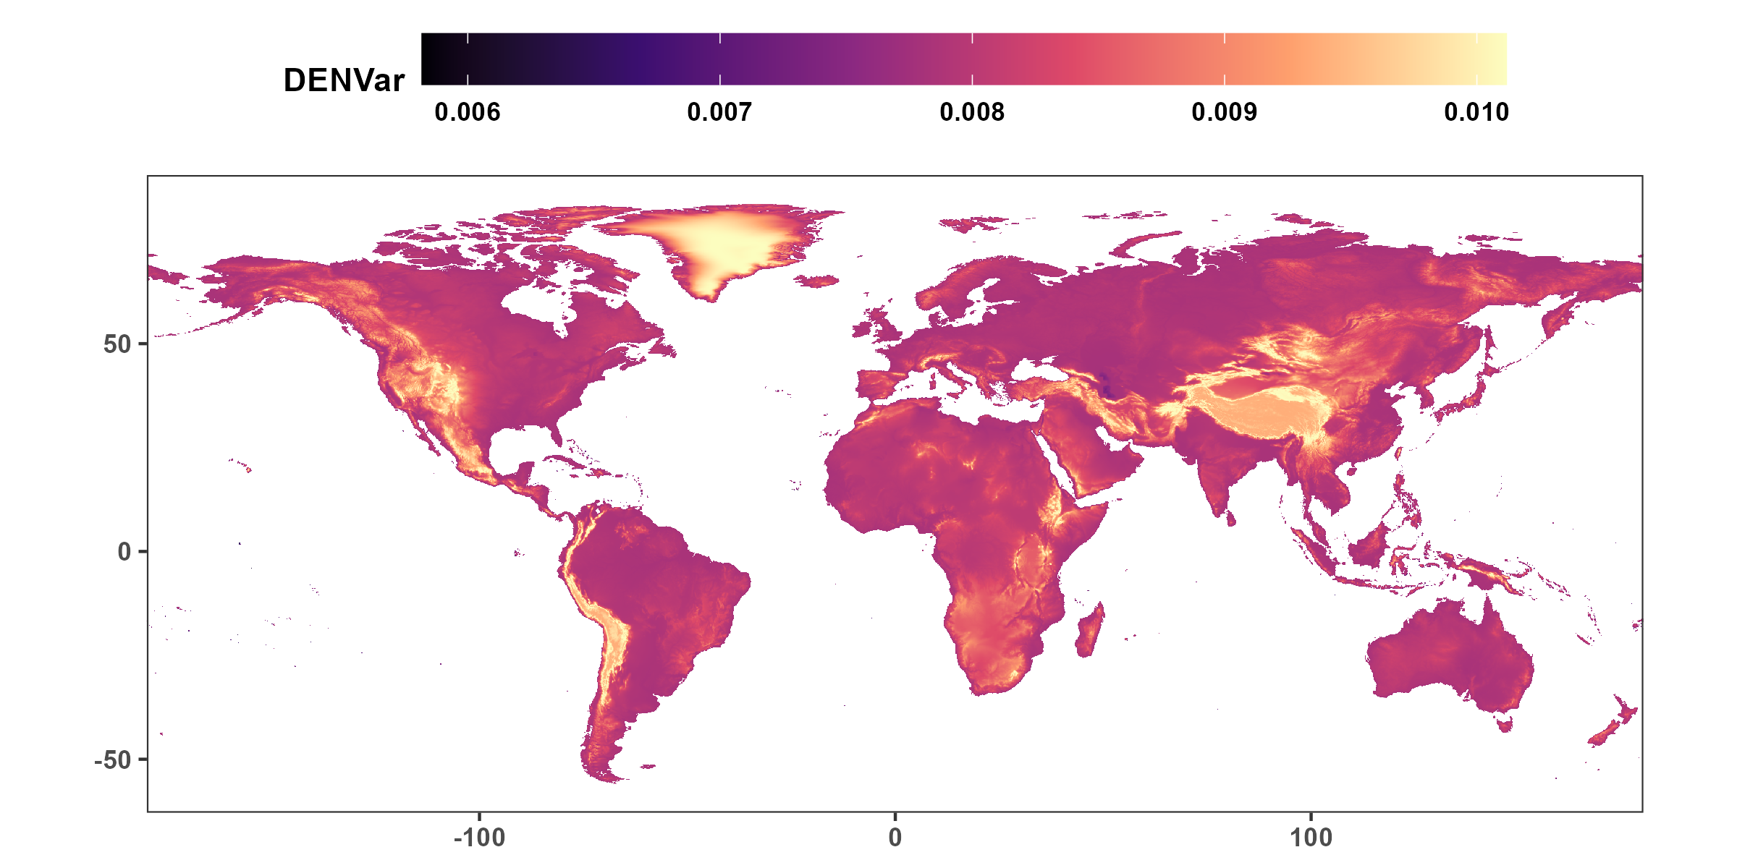
Model predictions: DENVar

